Slide 1


ESSENTIAL SKILLS FOR ANGULAR

Slide 2

1.
The Node Package Manager (npm) is practically a required tool for all web developers these days. Even if you’re not doing Node.js development, npm is the primary tool used to install thousands of client-side web development packages–including Angular. The entirety of Angular is spread across multiple npm packages and it’s very likely you will eventually have a need to install other useful, non-Angular packages as well. Therefore, knowing how to install what you need when you need it is valuable.

Slide 3
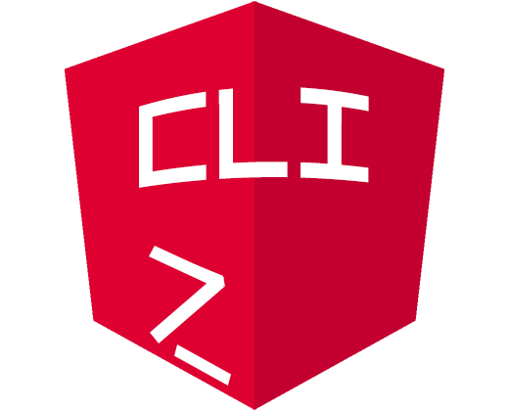
2.
The benefits of using the Angular CLI extend beyond the creation of a new application. You can also use it to add new components, services, modules and more to an existing app. This will save you lots of typing, ensure you follow Angular coding guidelines and guarantee you don’t forget the little bits and pieces that can mean the difference between functioning code and hours of head-scratching frustration.

Slide 4
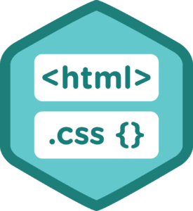
3.
Frameworks like Angular don’t eliminate the need for a thorough knowledge of the most fundamental web development technologies. Angular provides the building blocks you need to build fast, functional apps, but those apps still must be rendered in a browser and that means building user interfaces with HTML and CSS. Angular Material and other style libraries are great at helping you quickly deliver beautiful apps, but you need to know how and where to tweak things to achieve the precise look you’re trying to deliver. Frameworks come and go, but fundamentals like HTML and CSS are forever!

Slide 5
4.
Just about every Angular application will need forms, modules, components and services. Learn how to add and connect these pieces and you’ll have the skills necessary to build full-featured production applications. You’ll also have a solid foundation for continued learning and the implementation of increasingly sophisticated solutions.

Slide 6

5.
There are lots of reasons to use TypeScript instead of JavaScript, but at the top of the list are reduced bugs and an increased ability to confidently refactor your code. By taking advantage of strong typing, you can be sure you and your team are using variables and functions as they were intended to be used. This will undoubtedly reduce bugs in any large codebase. Also, using the power of TypeScript to confidently refactor your code means your app can continue to grow and evolve as the needs of your users change. You won’t find yourself stuck with large chunks of code you’re afraid to modify for fear of breaking existing functionality.

Slide 7

5.
RxJS is a library for reactive programming with observable streams. It exists independent of Angular but is bundled with the framework and used for many common tasks such as making HTTP requests for data. Angular uses observables and the other features of RxJS to provide a consistent API for performing asynchronous tasks.

Slide 8

6.
Third party UI control should use. Why? -
Performance
Good Documentation
Easy support
Community
Tested
Easily customize
Less Coding

Slide 9

कोई
सवाल ?

Slide 10



Contact me!
Nitin Pandit
donlynitin@outlook.com
(Solution Consultant at )
(Founder at )
(Awarded MVP by )
www.Nitin-Pandit.com

